Slide 1
104KM Enterprise Information System
Topic: Normalisation
Learning outcomes for today:
Data Redundancy
Functional Dependency
Process of Normalisation
Summary

Slide 2
Part 3
Normalisation

Slide 3
The Process of Normalization
Recalling normalization as a formal technique for analyzing relations based on their primary key (or candidate keys) and functional dependencies (Codd, 1972).
The process of normalization involves a series of rules used to test individual relations so that a database can be normalized to any degree.

Slide 4
The Process of Normalization
Relations violating requirement must be decomposed into relations that individually meet the requirement of normalization.
Three normal forms called First Normal Form (1NF), Second Normal Form (2NF), and Third Normal Form (3NF) were initially used.
Subsequently, an introduction of Boyce–Codd Normal Form (BCNF) is as a result of stronger definition of the third normal form by R. Boyce and E. F. Codd.

Slide 5
The Process of Normalization
With the exception of 1NF, all these normal forms are based on functional dependencies among the attributes of a relation (Maier, 1983).
Higher normal forms that go beyond BCNF were introduced later such as Fourth Normal Form (4NF) and Fifth Normal Form (5NF) (Fagin, 1977, 1979). However, these later normal forms deal with situations that are very rare. As such we shall not be covering them.
Normalization is often executed as a series of steps with each step corresponding to a specific normal form that has known properties.

Slide 6
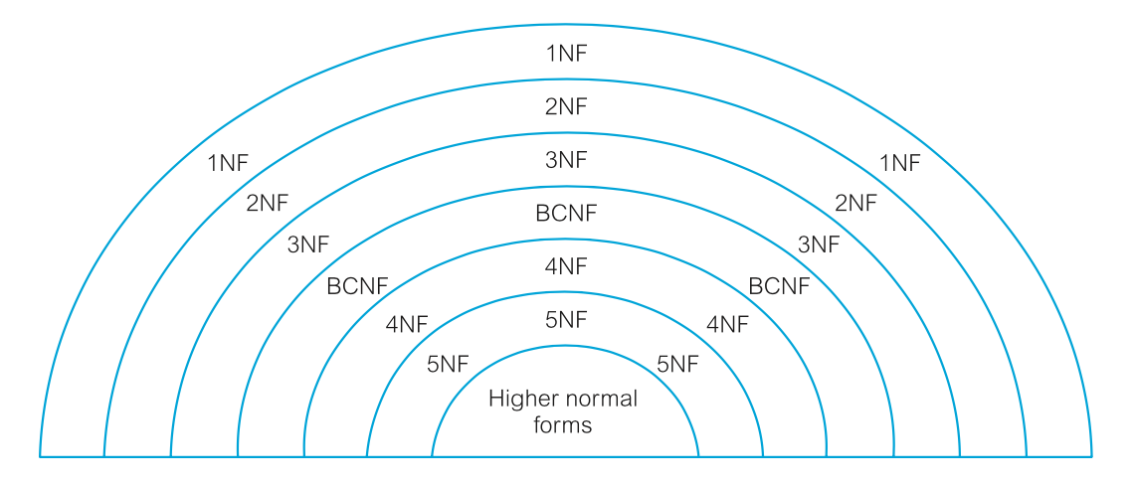
The Process of Normalization
As normalization proceeds, the relations become progressively more restricted in format and also less vulnerable to update anomalies.
For the relational data model, it is important to recognize that it is only First Normal Form (1NF) that is critical in creating relations; all subsequent normal forms are optional.
In other to avoid the update anomalies, it is recommended that we proceed to at least Third Normal Form (3NF).

Slide 7
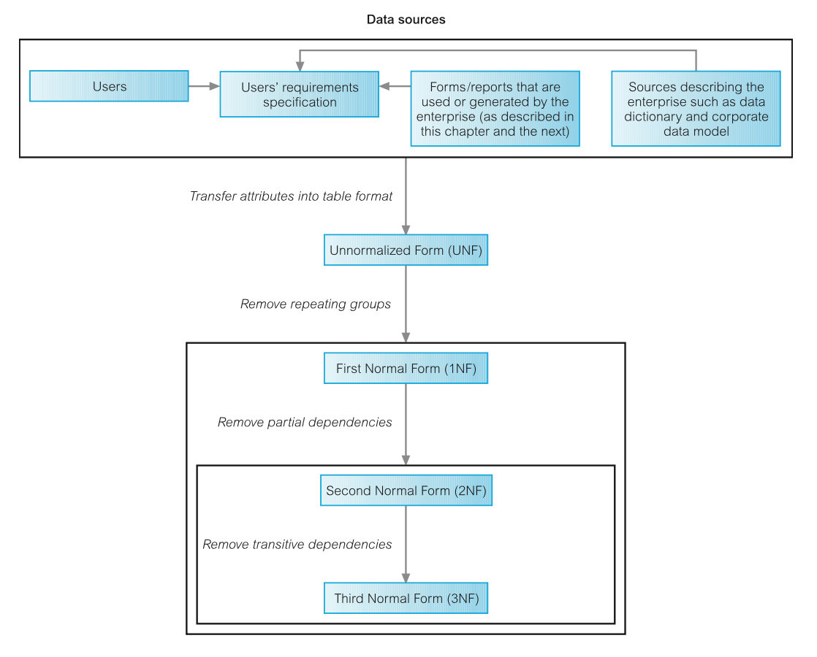
The Process of Normalization

Slide 8
First Normal Form (1NF)
Recalling that an Unnormalized form (UNF) is a table that contains one or more repeating groups.
We could define 1NF as a relation in which the intersection of each row and column contains one and only one value.
The process of normalization starts by first transferring the data from the source into table format with rows and columns.
This format is referred to as the UNF
To transform the table into 1NF, repeated groups within the table must be identified and removed.
A repeating group is an attribute, or group of attributes, within a table that occurs with multiple values for a single occurrence of the nominated key attribute(s) for that table.

Slide 9
First Normal Form (1NF)
Two common approaches are employed to removing repeating groups from unnormalized tables:
Entering appropriate data in the empty columns of rows containing the repeating data. This process is also known as the Flattening process
Placing the repeating data, along with a copy of the original key attribute(s), in a separate relation.
The resulting table used by either of the two approaches is referred to as the 1NF relations containing single values at the intersections of each row and column.

Slide 10
First Normal Form (1NF)
Two common approaches are employed to removing repeating groups from unnormalized tables:
Entering appropriate data in the empty columns of rows containing the repeating data.
Placing the repeating data, along with a copy of the original key attribute(s), in a separate relation.
The resulting table used by either of the two approaches is referred to as the 1NF relations containing single values at the intersections of each row and column.

Slide 11
First Normal Form (1NF)
Although both approaches are valid, approach 1 introduces more redundancy into the original UNF table as part of the “flattening” process, whereas approach 2 creates two or more relations with less redundancy than in the original UNF table.

Slide 12
Second Normal Form (2NF)
Is a relation that is in first normal form and every non-primary-key attribute is fully functionally dependent on the primary key.
The normalisation of 1NF relations to 2NF involves the removal of partial dependencies. If a partial dependency exists, we remove the partially dependent attribute(s) from the relation by placing them in a new relation along with a copy of their determinant.

Slide 13
Third Normal Form (3NF)
Is a relation that is in first and second normal form in which non-primary-key attribute is transitively dependent on the primary key.
The normalization of 2NF relations to 3NF requires updating two tuples in the relation. If only one tuple is updated and not the other, the database would be in an inconsistent state.
This anomaly is caused by a transitive dependency, we need to remove such dependencies by progressing to third normal form.
The normalization of 2NF relations to 3NF involves the removal of transitive dependencies. If a transitive dependency exists, we remove the transitively dependent attribute(s) from the relation by placing them in a new relation along with a copy of their determinant.

Slide 14
Normalization Example 2
Taking the slightly modified data provided in the second activity of Week two’s lab, we can have the following table version in UNF format.
Employee
Employee_Name | Employee_Addr | Job_Role | Salary
Ali | 12A,Plymouth Road,Devon | Accountant | 40 000
Mary | 423,Tudor Avenue, Coventry | HR Manager | 30 000
John | 3,Merlin Close, London | Database Administrator | 60 000
Peter | 10, Jardine Road, Manchester | Programmer | 50 000
Department_Name | Project_Name | Project_Start_Date | Project_End_Date | Total_Hours
Finance Depratment | Project_XXX | 6/1/2013 | 6/4/2013 | 420
HR Department | Project_YYY | 10/5/2013 | 10/6/2013 | 140
IT Department | Project_YYY | 10/5/2013 | 10/6/2013 | 140
IT Department | Project_ZZZ | 1/8/2015 | 31/8/2015 | 100

Slide 15
Normalization Example 2
1NF: the intersection of each row and column contains one and only one value.
Employee_Addr contains Address and City as well
1NF: undefined unique key allows for duplicate entries
Employee
Employee_Name | Employee_Addr | Job_Role | Salary
Ali | 12A,Plymouth Road,Devon | Accountant | 40 000
Mary | 423,Tudor Avenue, Coventry | HR Manager | 30 000
John | 3,Merlin Close, London | Database Administrator | 60 000
Peter | 10, Jardine Road, Manchester | Programmer | 50 000
Department_Name | Project_Name | Project_Start_Date | Project_End_Date | Total_Hours
Finance Depratment | Project_XXX | 6/1/2013 | 6/4/2013 | 420
HR Department | Project_YYY | 10/5/2013 | 10/6/2013 | 140
IT Department | Project_YYY | 10/5/2013 | 10/6/2013 | 140
IT Department | Project_ZZZ | 1/8/2015 | 31/8/2015 | 100

Slide 16
Normalization Example 2
1NF: the intersection of each row and column contains one and only one value.
Employee_Addr split into Address and City
1NF: undefined unique key allows for duplicate entries
Added Employee_Id as unique Key
Employee
Employee_Id | Employee_Name | Address | City | Job_Role | Salary
E110 | Ali | 12A,Plymouth Road | Devon | Accountant | 40 000
E111 | Mary | 423,Tudor Avenue | Coven-try | HR Manager | 30 000
E112 | John | 3,Merlin Close | London | Database Administrator | 60 000
E113 | Peter | 10, Jardine Road | Man-chester | Programmer | 50 000
Department_Name | Project_Name | Project_Start_Date | Project_End_Date | Total_Hours
Finance Depratment | Project_XXX | 6/1/2013 | 6/4/2013 | 420
HR Department | Project_YYY | 10/5/2013 | 10/6/2013 | 140
IT Department | Project_YYY | 10/5/2013 | 10/6/2013 | 140
IT Department | Project_ZZZ | 1/8/2015 | 31/8/2015 | 100

Slide 17
Normalization Example 2
2NF: every non-primary attribute is functionally dependent on the primary key. Functional Dependencies violating this:
fd2: Project_Name ® Project_Start_Date, Project_End_Date, Total_Hours
We consider that:
The same address could be found in multiple cities
Same job could be found in multiple Departments
Employee
Employee_Id | Employee_Name | Address | City | Job_Role | Salary
E110 | Ali | 12A,Plymouth Road | Devon | Accountant | 40 000
E111 | Mary | 423,Tudor Avenue | Coven-try | HR Manager | 30 000
E112 | John | 3,Merlin Close | London | Database Administrator | 60 000
E113 | Peter | 10, Jardine Road | London | Programmer | 50 000
Department_Name | Project_Name | Project_Start_Date | Project_End_Date | Total_Hours
Finance Depratment | Project_XXX | 6/1/2013 | 6/4/2013 | 420
HR Department | Project_YYY | 10/5/2013 | 10/6/2013 | 140
IT Department | Project_YYY | 10/5/2013 | 10/6/2013 | 140
IT Department | Project_ZZZ | 1/8/2015 | 31/8/2015 | 100

Slide 18
Normalization Example 2
2NF: every non-primary attribute is functionally dependent on the primary key.
We create table Project so satisfy 2NF
1NF: undefined unique key allows for duplicate entries
Project
Added Project_Id Key as Project_Name could be duplicate
Project_Id | Project_Name | Project_Start_Date | Project_End_Date | Total_Hours
P1 | Project_XXX | 6/1/2013 | 6/4/2013 | 420
P2 | Project_YYY | 10/5/2013 | 10/6/2013 | 140
P3 | Project_ZZZ | 1/8/2015 | 31/8/2015 | 100
Employee
Employee_Id | Employee_Name | Address | City | Job_Role | Salary | Department_Name | Project_Id
E110 | Ali | 12A,Plymouth Road | Devon | Accountant | 40 000 | Finance Department | P1
E111 | Mary | 423,Tudor Avenue | Coventry | HR Manager | 30 000 | HR Department | P2
E112 | John | 3,Merlin Close | London | Database Administrator | 60 000 | IT Department | P2
E113 | Peter | 10, Jardine Road | London | Programmer | 50 000 | IT Department | P3

Slide 19
Normalization Example 2
3NF: every non-primary attribute should provide information only on the primary attribute.
Job Role and Department_Name don’t satisfy this constraint
Project
Project_Id | Project_Name | Project_Start_Date | Project_End_Date | Total_Hours
P1 | Project_XXX | 6/1/2013 | 6/4/2013 | 420
P2 | Project_YYY | 10/5/2013 | 10/6/2013 | 140
P3 | Project_ZZZ | 1/8/2015 | 31/8/2015 | 100
Employee
Employee_Id | Employee_Name | Address | City | Job_Role | Salary | Department_Name | Project_Id
E110 | Ali | 12A,Plymouth Road | Devon | Accountant | 40 000 | Finance Department | P1
E111 | Mary | 423,Tudor Avenue | Coventry | HR Manager | 30 000 | HR Department | P2
E112 | John | 3,Merlin Close | London | Database Administrator | 60 000 | IT Department | P2
E113 | Peter | 10, Jardine Road | London | Programmer | 50 000 | IT Department | P3

Slide 20
Normalization Example 2
3NF: every non-primary attribute should provide information only on the primary attribute.
Job_Id | Job_Role
J1 | Accountant
J2 | HR Manager
J3 | Database Administrator
J4 | Programmer
We create Job and Department Tables
1NF: undefined unique key allows for duplicate entries
Added Job_Id and Department_Id Keys as Job and Department Name could be duplicate
Project_Id | Project_Name | Project_Start_Date | Project_End_Date | Total_Hours
P1 | Project_XXX | 6/1/2013 | 6/4/2013 | 420
P2 | Project_YYY | 10/5/2013 | 10/6/2013 | 140
P3 | Project_ZZZ | 1/8/2015 | 31/8/2015 | 100
Employee_Id | Employee_Name | Address | City | Job_Id | Salary | Department_Name | Project_Id
E110 | Ali | 12A,Plymouth Road | Devon | J1 | 40 000 | D1 | P1
E111 | Mary | 423,Tudor Avenue | Coventry | J2 | 30 000 | D2 | P2
E112 | John | 3,Merlin Close | London | J3 | 60 000 | D3 | P2
E113 | Peter | 10, Jardine Road | London | J4 | 50 000 | D4 | P3
Department_Id | Department_Name
D1 | Finance Department
D2 | HR Department
D3 | IT Department

Slide 21
Summary
Normalisation is a design technique that is widely used as a guide in designing relational databases.
The objective of normalisation:
“to create relations where every dependency is on the key, the whole key, and nothing but the key”.

